Slide 1

May 13th 2024
RAGE
Energy Consumption Prediction Framework in Model-based Development for Edge Devices
Yue Hou and Takuya Azumi
Graduate School of Science and Engineering,
Saitama University
Notes:
Hello, everyone. My name is Yue Hou, a graduate school student from Saitama University in Japan.
Today, I’ll give a presentation on my research which names [Energy Consumption Prediction Framework in Model-based Development for Edge Devices}

Slide 2
Outline
Background
Proposed Method
Evaluation
Conclusion

Slide 3
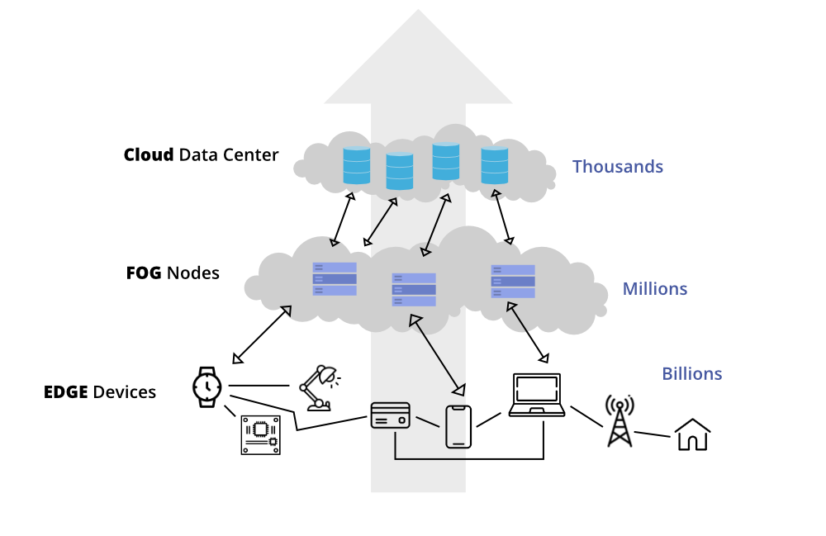
Edge Devices
[Background]
Development of Edge Devices
The count of devices is increasing
Systems is becoming complex
Development of Systems on Edge Devices
The cost is becoming significant
The reusability of the code developed with traditional method is limited

Slide 4
Edge Devices
[Background]
Concerns about Energy Consumption
Edge devices are desired to operate at low power due to hardware constraints
Energy consumption analysis of code can provide direction and validation for code optimization

Slide 5




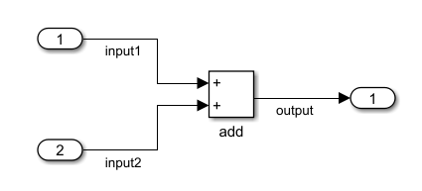
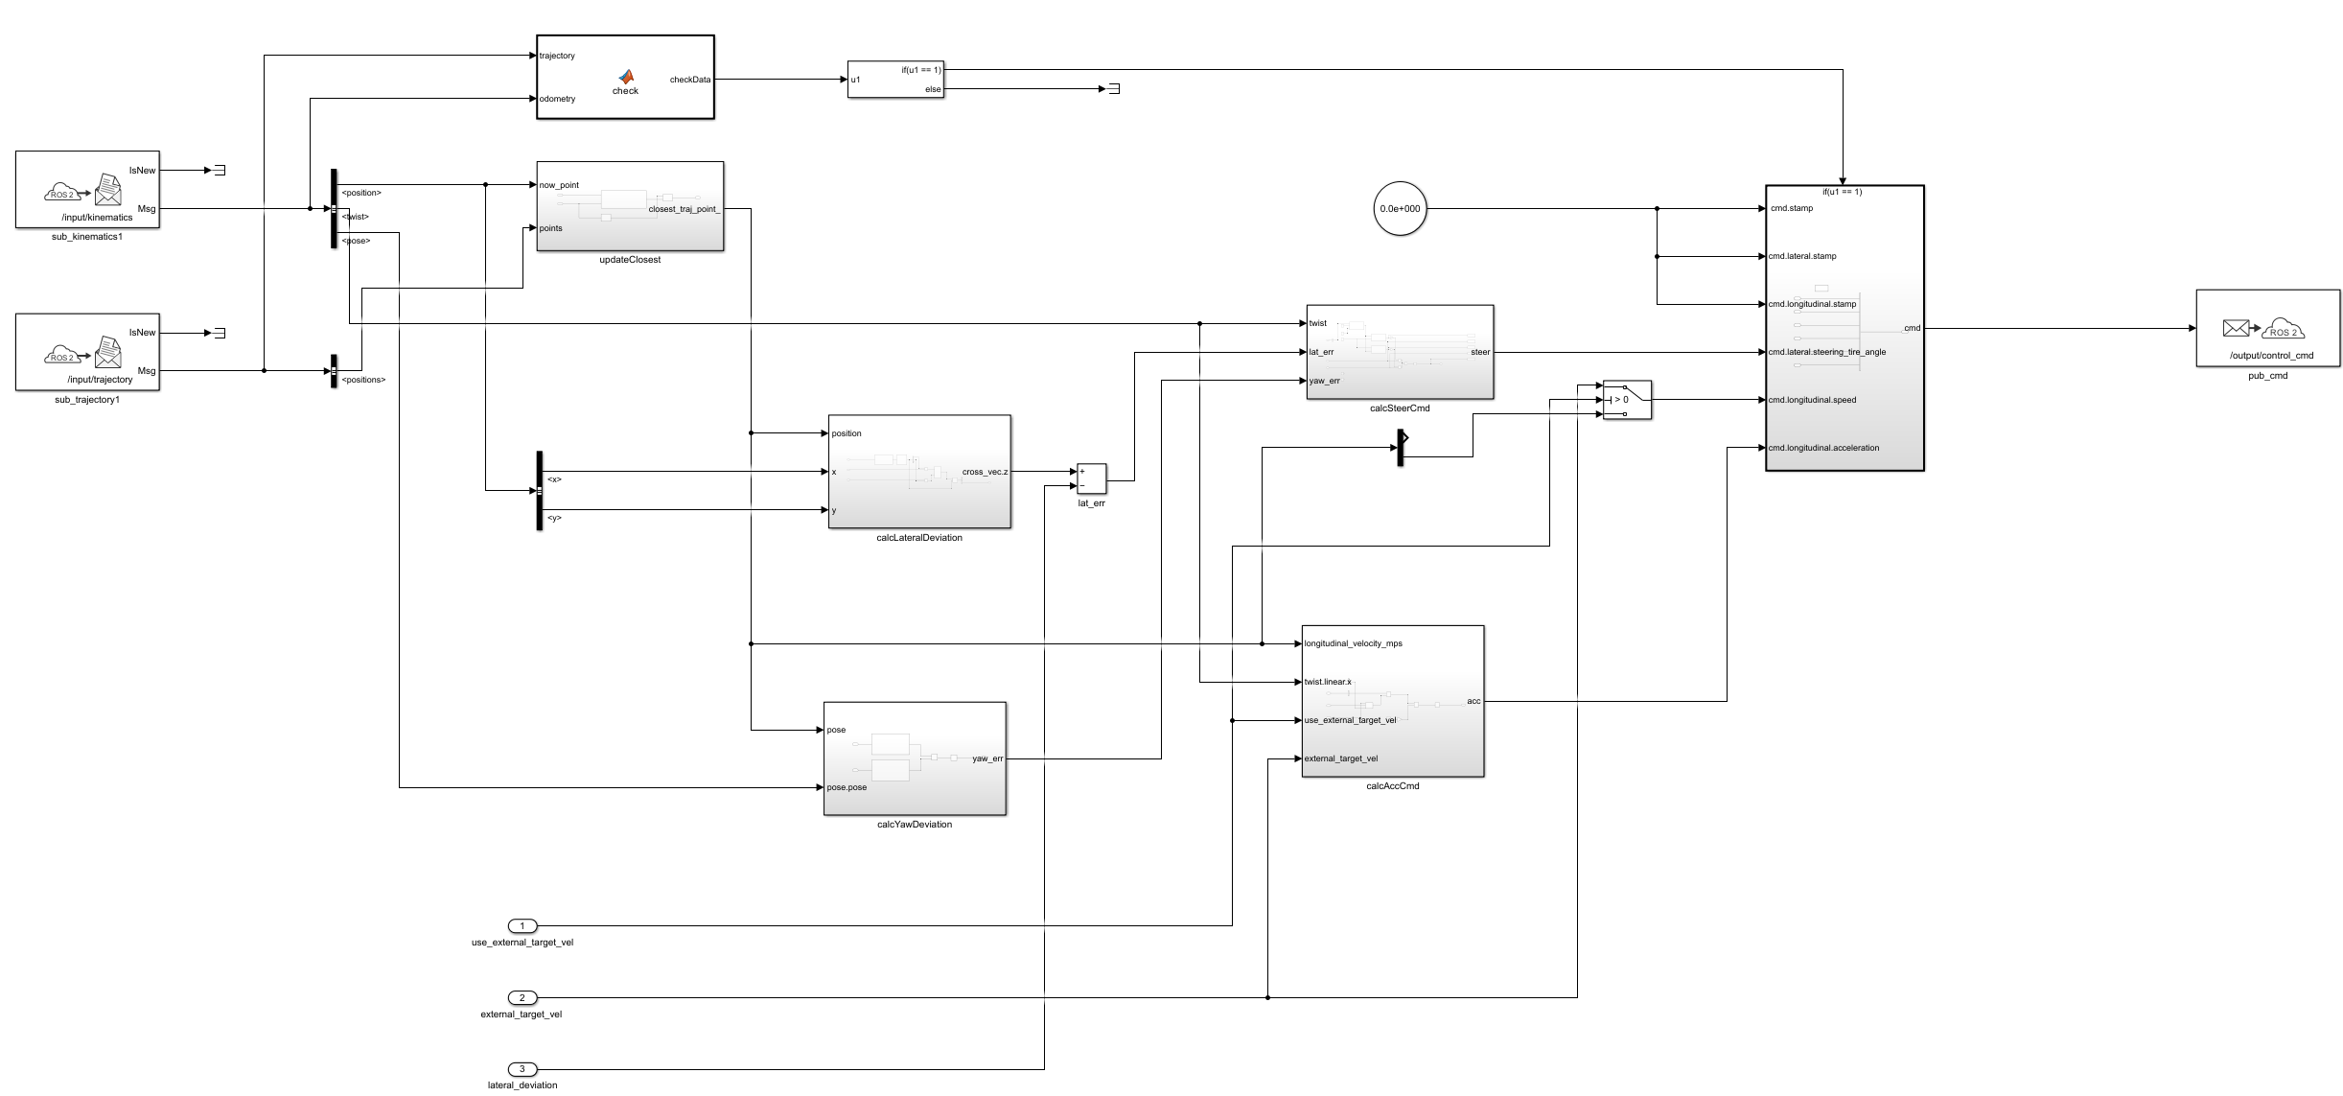
Model-based Development (MBD)
[Background]
MATLAB/Simulink
MATLAB: a programming and numeric computing platform developed by MathWorks
Simulink: a block diagram environment for Model-based Development integrated with MATLAB

Slide 6
Model-based Development (MBD)
[Background]
V-Model
A structured approach to system development that mirrors the stages of development with corresponding testing phases
Notes:
The V-Model in Model-Based Development
The V-Model is a structured approach to system development that mirrors the stages of development with corresponding testing phases, forming a V-like diagram. It is especially prevalent in Model-Based Development (MBD), where the emphasis is on developing and validating system models early in the design process.

Slide 7
Model-based Development (MBD)
[Background]
Design Phase
Requirements Analysis
Basic Design: simulation based on model
Detailed Design
Design Phase
Test Phase
Notes:
The V-Model in Model-Based Development
The V-Model is a structured approach to system development that mirrors the stages of development with corresponding testing phases, forming a V-like diagram. It is especially prevalent in Model-Based Development (MBD), where the emphasis is on developing and validating system models early in the design process.

Slide 8
Low Level Virtual Machine Intermediate Representation （LLVM-IR）
[Background]
LLVM-IR
A low-level programming language used as the primary IR within the LLVM compiler framework
Serves as a bridge between high-level languages and the machine code, enabling code analysis and transformation
Notes:
The V-Model in Model-Based Development
The V-Model is a structured approach to system development that mirrors the stages of development with corresponding testing phases, forming a V-like diagram. It is especially prevalent in Model-Based Development (MBD), where the emphasis is on developing and validating system models early in the design process.

Slide 9
Contribution
[Proposed Method]
［Contribution 1］ A schema is proposed to describe the energy consumption of instructions
［Contribution 2］ A method is proposed for extracting the working portion from generated code and transforming it into LLVM-IR
［Contribution 3］ A software tool is designed to predict model energy consumption

Slide 10
Contribution
[Proposed Method]
［Contribution 1］ A schema is proposed to describe the energy consumption of instructions
［Contribution 2］ A method is proposed for extracting the working portion from generated code and transforming it into LLVM-IR
［Contribution 3］ A software tool is designed to predict model energy consumption

Slide 11
Energy Consumption Description Schema
[Proposed Method]
Schema
Provide a universal framework to describe energy consumption for any given instruction

Slide 12
Energy Consumption Description Schema
[Proposed Method]
Three-Tier Structure
Top Layer
CommonInstructionSet
Middle Layer
Instruction
Bottom Layer
PowerConsumption
<CommonInstructionSet>
<Instruction name="example">
<PowerConsumption>
<Cost>1.000</Cost> <Impact>0.000</Impact> </PowerConsumption>
</Instruction>
</CommonInstructionSet>

Slide 13
Energy Consumption Description Schema
[Proposed Method]
Acquisition Method
Time and Energy
Execution time is directly linked to energy consumption
Method
A cyclic execution approach is used for better precision in measuring individual instructions' time and energy use
for (uint_t i = 0; i <= iteration; i++)
{
asm volatile(”nop”)
}
Empty Body
for (uint_t i = 0; i <= iteration; i++)
{
asm volatile(”nop”)
asm volatile(
”ADD %0, %1, %2\n\t”
:”=r”(r6)
:”r”(r4), ”r”(r5));
}
Measured Body

Slide 14
Contribution
[Proposed Method]
［Contribution 1］ A schema is proposed to describe the energy consumption of instructions
［Contribution 2］ A method is proposed for extracting the working portion from generated code and transforming it into LLVM-IR
［Contribution 3］ A software tool is designed to predict model energy consumption

Slide 15
Extracting Working Portion
[Proposed Method]
Function Call
Call the main function section in the generated file by means of a function call in the new .c file

Slide 16
Contribution
[Proposed Method]
［Contribution 1］ A schema is proposed to describe the energy consumption of instructions
［Contribution 2］ A method is proposed for extracting the working portion from generated code and transforming it into LLVM-IR
［Contribution 3］ A software tool is designed to predict model energy consumption

Slide 17
Prediction Tool
[Proposed Method]
Input
Schema
LLVM-IR Code
Output
Prediction of code’s energy consumption

Slide 18
Comparison with Other Methods
[Proposed Method]
 | Modeling | Code Generation | Energy Consumption Measurement | Energy Consumption Prediction
MDD [7] | ○ | ○
Mercury [8] | ○ | ○
IEEE Access [9] |  |  | ○
SDK4ED [10] |  |  | ○ | ○
J4CS [11] |  |  | ○ | ○
PARTSim [12] |  |  | ○ | ○
This Paper | ○ | ○ | ○ | ○
Other approaches either focus purely on MBD or on code energy consumption prediction
Our research fuses the prediction process into MBD, enabling code energy prediction at the primary stage of development

Slide 19
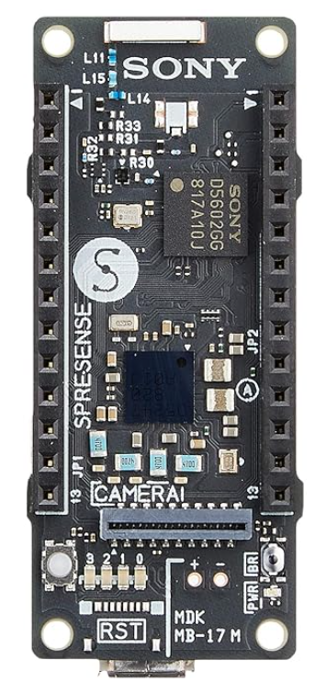
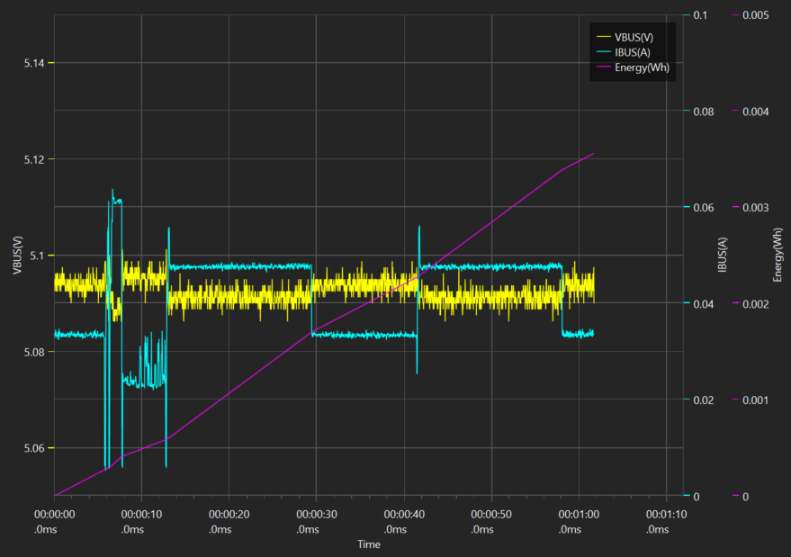
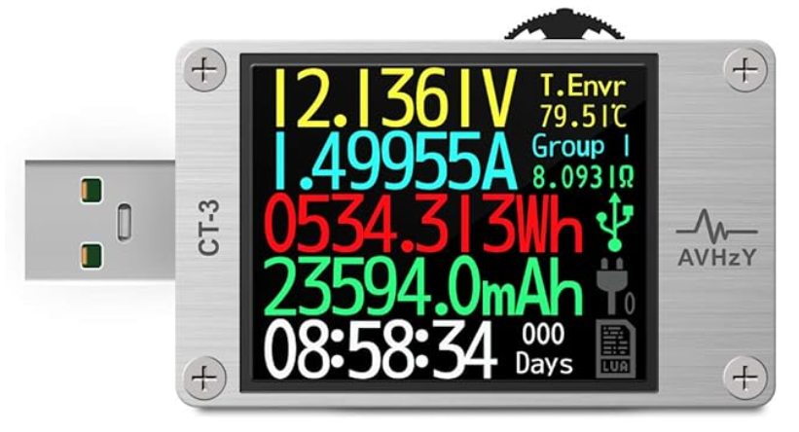
Experimental Environment
[Evaluation]
Target device
SONY Spresense (ARM Cortex M4F)
Measurement device
AVHzY CT-3 USB tester

Slide 20
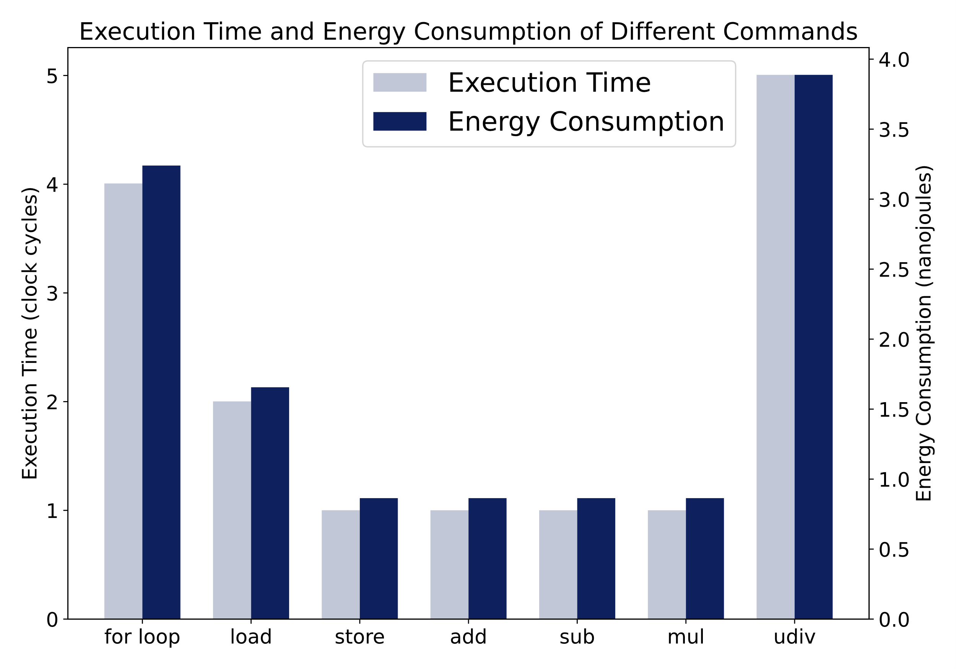
Experimental
[Evaluation]
Basic Evaluation
Measure the power consumption and execution time of basic instructions on the target device
Create test scripts to obtain actual execution time and power consumption in a single core environment
Notes:
Code execution time is closely related to energy consumption, and to predict energy consumption, code time estimation can be synchronized and used as a validation.
To this end, we have listed the following basic evaluations
To guarantee cross-platform and cross-architecture properties, the Low Level Virtual Machine Intermediate Representation (LLVM-IR) code is used in the experiment.
LLVM-IR provides a unified, hardware-independent basic instruction set.
First, it measures the power consumption and execution time of the basic instructions on the target device.
We also create a test script to obtain the actual execution time and power consumption in a single-core environment.
Finally, based on the measured single instruction data, predictions are made at the LLVM-IR instruction level and compared to the measured values to analyze the prediction accuracy.
The figure shows the measured power consumption and execution time of a number of basic instructions. The unit of execution time is cycles, and the unit of energy is nanojoules

Slide 21
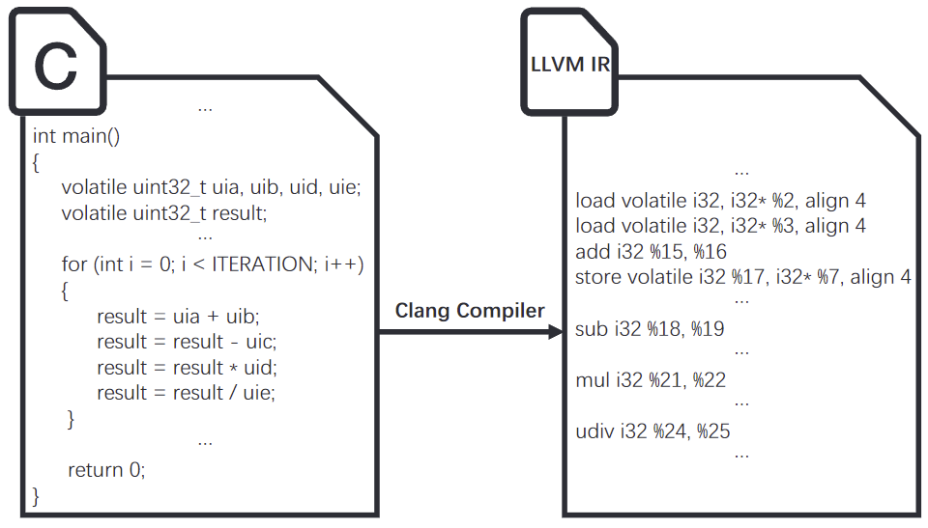
Experimental
[Evaluation]
Basic Evaluation
Test Scripts
Four arithmetic operations（add,sub,mul, and div）
Predicting power consumption
Focus on the “for” statement part
Test Scripts
Notes:
In order to verify the feasibility of our proposed approach
The test script performs a simple four arithmetic operations.
in this case, we focus only on the for statement, so when the number of loops is small, the error is large.As the number of loops is increased, the error gradually decreases.

Slide 22
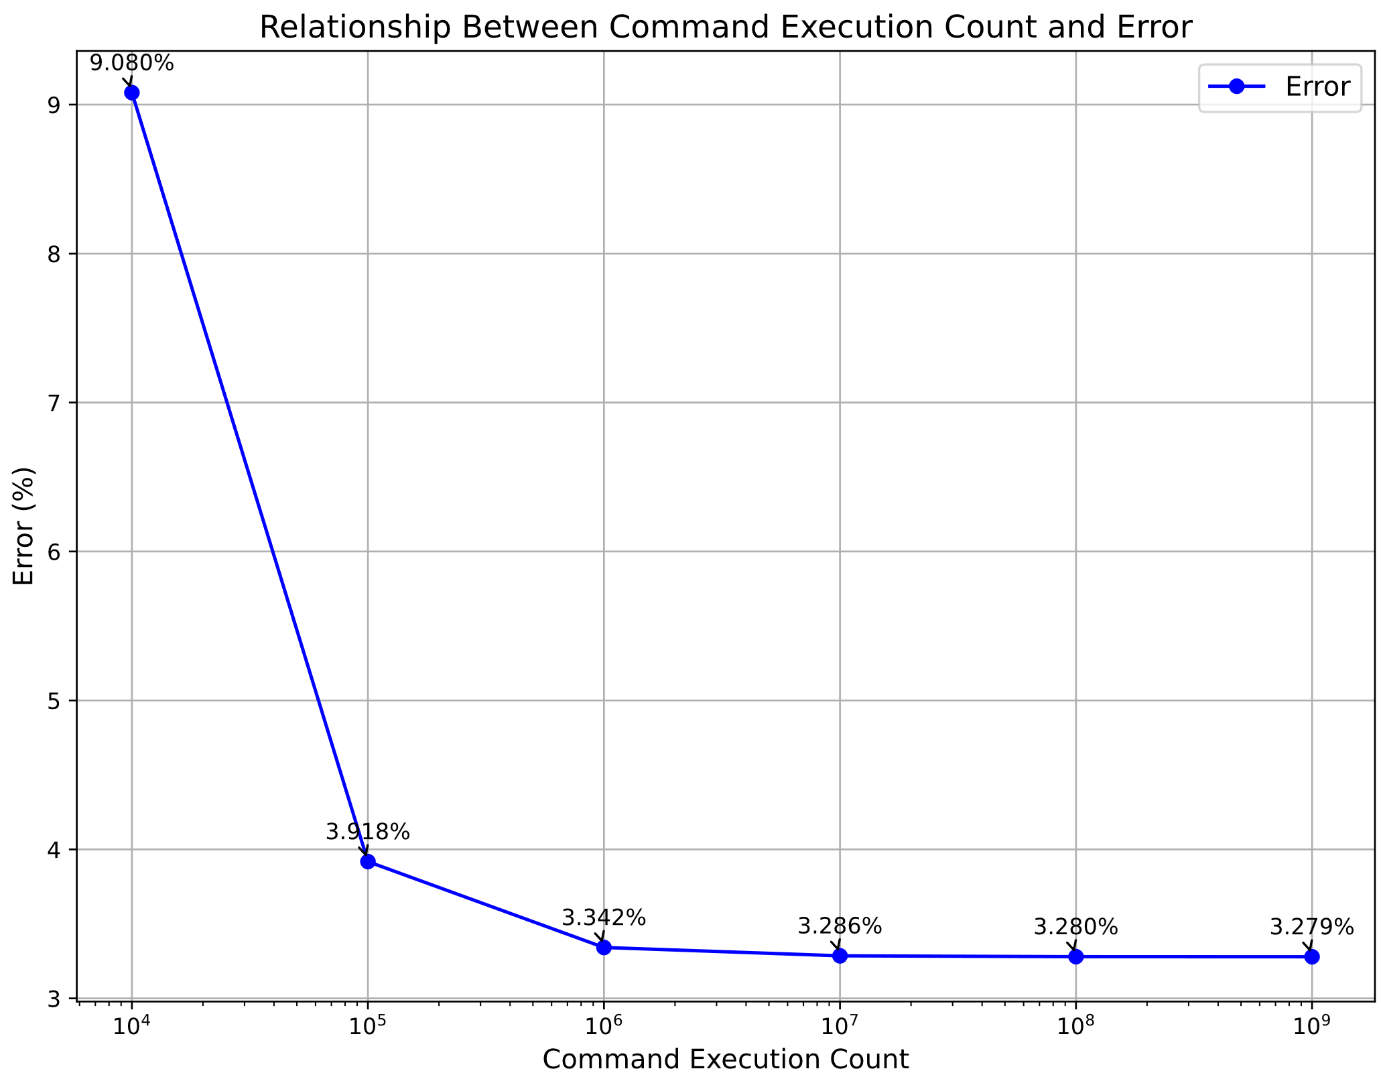
Experimental
[Evaluation]
Basic Evaluation
 | Number of Execution | Total Time (clock cycles) | Total Energy (nanojoules)
load | 8 | 16.018 | 13.248
store | 4 | 4.005 | 3.456
add | 1 | 1.001 | 0.864
sub | 1 | 1.001 | 0.864
mul | 1 | 1.001 | 0.864
udiv | 1 | 5.006 | 3.888
for | 1 | 4.007 | 3.24
Total |  | 32.039 | 26.424
Time and Energy Consumption of Instructions
Power Consumption Prediction Focus on “for”
Notes:
In order to verify the feasibility of our proposed approach
The test script performs a simple four arithmetic operations.
in this case, we focus only on the for statement, so when the number of loops is small, the error is large. As the number of loops is increased, the error gradually decreases.

Slide 23
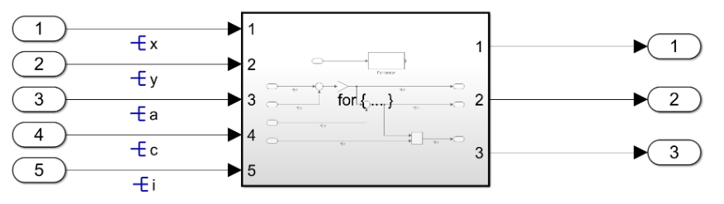
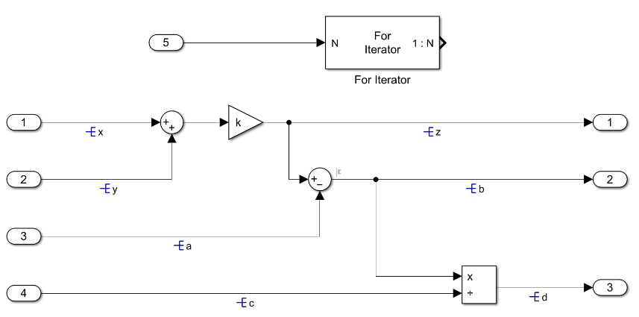
Experimental
[Evaluation]
Evaluation with Models
Overall Model Construction
For Iterator Subsystem Construction
Notes:
In addition, an evaluation using a model was conducted to determine if the proposed schema and estimation method are applicable in model-based development.
The model we prepared is shown in the figure below, using the for subsystem to perform the four arithmetic operations.
In the actual case, the model works by receiving information from the outside and passing it to the model after the process is complete, and the test model is also used in the function call.

Slide 24
Experimental Environment
[Evaluation]
Evaluation with Models
Code generated by Embedded Coder
Execute in user code with function calls
Convert to LLVM-IR instructions
Make predictions with the proposed tool
for (si_iter = 1; si_iter <= temp; si_iter ++)
{
z = ( x + y) * k;
b = z – a;
d = b / c;
}

Slide 25
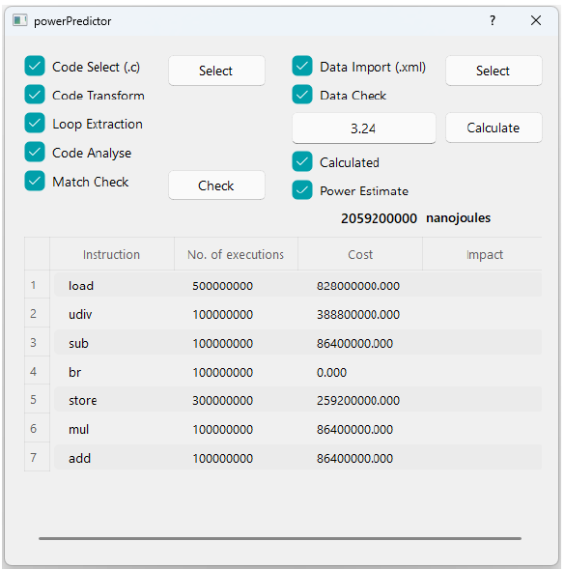
Experimental Environment
[Evaluation]
Evaluation with Models
Result
Prediction
2,059,200,000 nJ
Measurement
1,980,000,000 nJ
Error: 4%
Error Analysis
Focus on “for” statement
Other codes’ ignored
Precision of the equipment
1,000 times per second

Slide 26
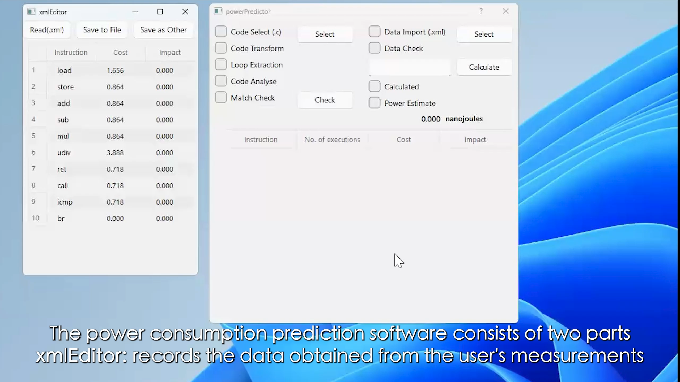
Experimental Environment
[Evaluation]
Software Use Case

Slide 27
Conclusions
Proposed Method
Schema Construction: a structured approach to modeling energy consumption
Module Extraction: parts of the model relevant to energy consumption
Energy Consumption Prediction Tool: software to predict energy consumption
Contributions
A schema is proposed to describe the energy consumption of instructions
A method is proposed for extracting the working portion from generated code and transforming it into LLVM-IR
A software tool is designed to predict model energy consumption
Evaluaion
Validate the availability of schema through basic evaluation
The usability of the method in Model-based Development is verified by means of actual model

Slide 28
新規性は何ですか?

Slide 29
何が難しいんですか?

Slide 30
実装で何が難しかったですか?

Slide 31
既存研究と比べて何が良いんですか？

Slide 32
既存研究で提案手法が使われないのは何故?

Slide 33
どこまでが自分で提案した部分ですか

Slide 34
何故この研究をやろうと決めたのですか？

Slide 35
この研究に必要性はあるのか？

Slide 36
想定しているユーザは誰ですか？

Slide 37
工夫したことは何ですか？

Slide 38
その評価を選んだ理由は何ですか？

Slide 39
評価は優位的な差があると言えるのか?

Slide 40
今後の展望などはありますか？

